Slide 1
Synthetic Intelligence for Brain MRI Augmentation using GAN
VIII Semester : Internship Project
Project Associate:
Sphoorthi B S - sphoorthisavalgi01@gmail.com
Siddarth J K - siddarthkarbhari@gmail.com

Slide 2
Index
Introduction
Problem Statement
Objectives
Dataset Description
Implementation
Results
Conclusion

Slide 3
Introduction
Brain tumors are one of the most life-threatening forms of cancer affecting the central nervous system. Early detection through MRI imaging plays a crucial role in diagnosis and treatment planning.
Traditional diagnostic processes often rely on radiologist expertise, which can be subjective and time-consuming. The integration of Artificial Intelligence (AI), particularly deep learning, in medical image analysis has shown remarkable potential in automating and enhancing diagnostic accuracy.
One of the key limitations in training high-performance deep learning models is the lack of sufficient annotated medical data. This challenge is amplified in brain tumor datasets due to privacy concerns, patient variability, and the complexity of MRI modalities. To address this limitation, our project employs Deep Convolutional Generative Adversarial Networks (DCGANs) to synthetically augment the existing dataset, increasing both size and diversity.

Slide 4
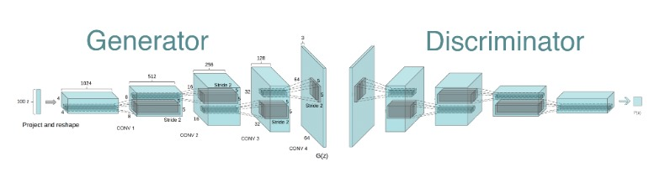
Problem Statement
To develop a portable application for classification of brain MRI images into tumor and non-tumor categories using GAN, thereby improving diagnostic efficiency and accuracy.

Slide 5
Objectives
To automate brain tumor detection process.
To develop an application for Tumor detection.
To implement data preprocessing and augmentation techniques using DCGAN.
To train a CNN model.
To evaluate the model’s performance.

Slide 6
Dataset Description
The dataset is organized into three major directories:
train — Used for training machine learning models.
val — Used for validation during model training.
test — Used for final model evaluation/testing.
Each of these is further divided into two subfolders:
1 — Presumably positive class: tumor-present images.
2 — Presumably negative class: tumor-absent (healthy) images.

Slide 7
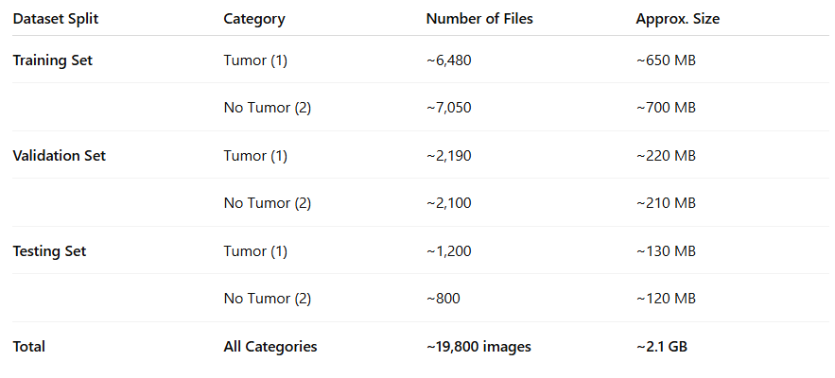
Dataset Description
Dataset Size -2.1 GB

Slide 8
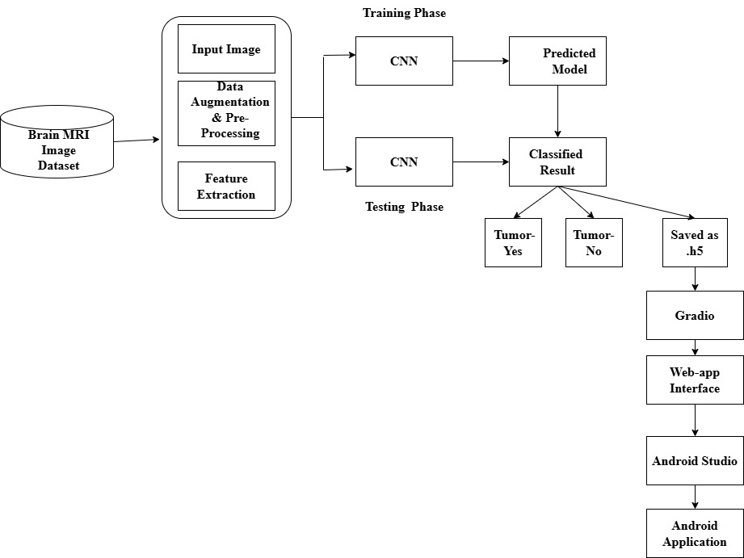
System Architecture

Slide 9
Implementation
To overcome the challenge of limited MRI image data for brain tumor classification, a Deep Convolutional Generative Adversarial Network (DCGAN) is employed for data augmentation. The synthetic images generated by DCGAN help improve the performance and generalization of deep learning classification models.
1. Dataset Preparation
The dataset is divided into Train, Validation, and Test sets.
Two classes: Tumor (1) and No Tumor (2).
Images are preprocessed
Resized (commonly to 64×64 pixels)
Normalized (pixel values scaled between -1 and 1 for GAN training)

Slide 10
Implementation
B. Discriminator (D)
Input: Real or generated image
Output: Probability (real or fake)
Layers:
Conv2D layers
LeakyReLU activation
Batch Normalization
Final layer: Sigmoid
A. Generator (G)
Output: Fake MRI image resembling a real tumor or non-tumor scan
Layers:
Fully connected layer → reshape
Transposed Conv2D (Deconvolution) layers
Batch Normalization
ReLU activation (except last layer: Tanh)

Slide 11
Implementation

Slide 12
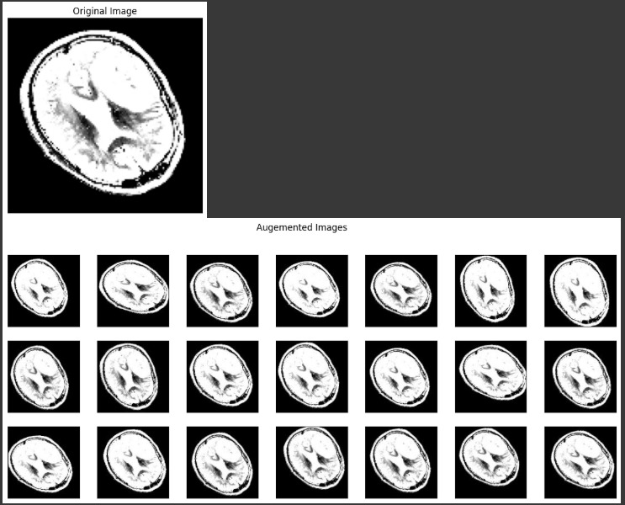
Implementation
Image Generated by DCGAN

Slide 13
Implementation
CNN (Baseline Model)
Layers includes:
3–4 Conv2D layers
Max Pooling and Dropout for regularization
Dense layers for classification
Input: Preprocessed 64x64 MRI images
Output: Binary classification (Tumor / No Tumor)

Slide 14
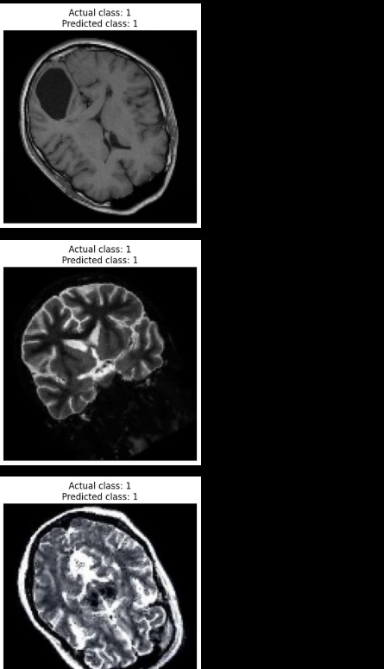
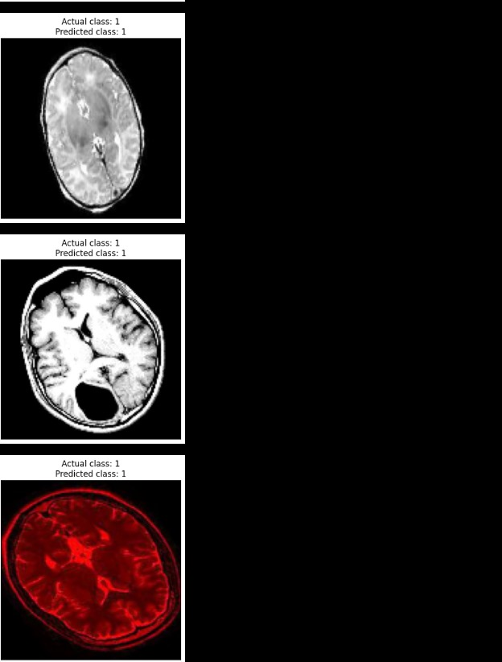
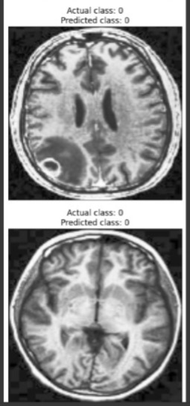
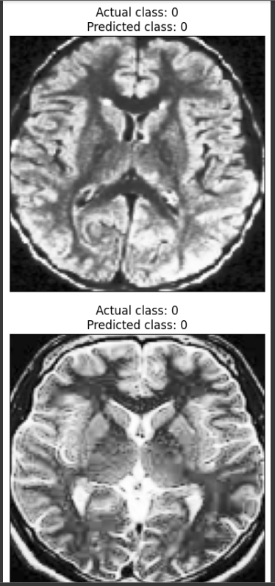
Results
Tumor Detected
Tumor Not Detected

Slide 15
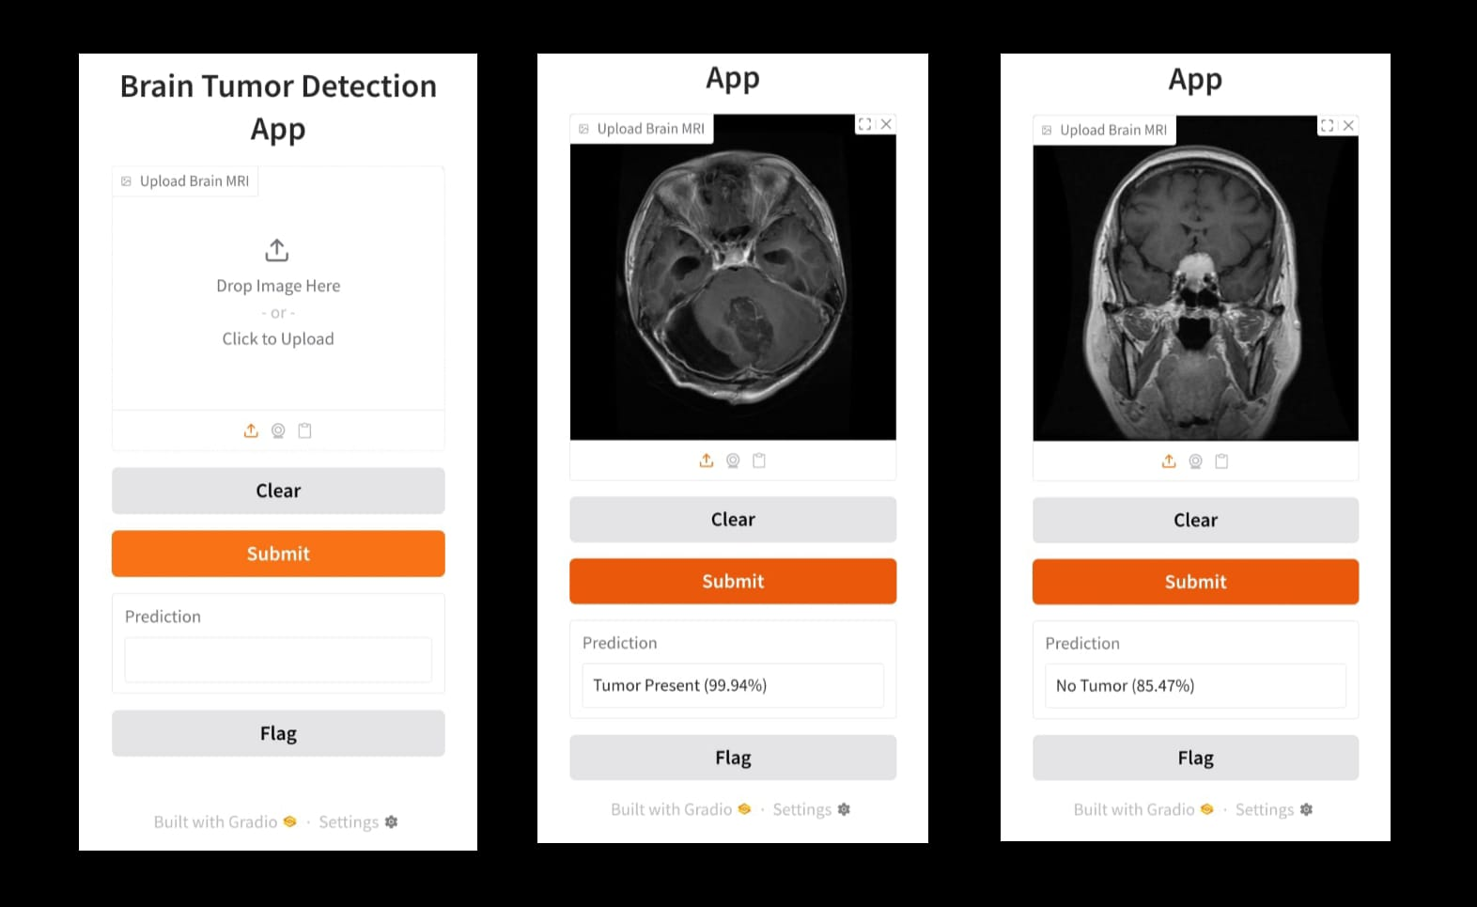
Results
Application Interface

Slide 16
THANK-YOU

